Slide 1
Predictive Analytics

Slide 2
Predictive Analytics-Introduction
Predictive analytics is a form of advanced analytics that uses both new and historical data to forecast activity, behaviour and trends.

Slide 3
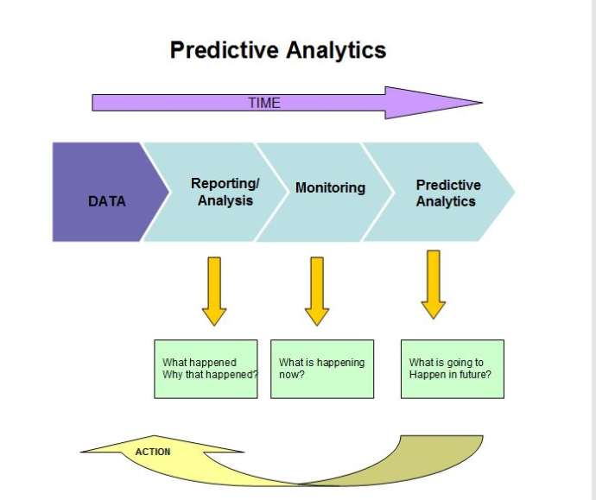
How it works?
Uses many techniques from data mining, statistics, machine learning & artificial intelligence to analyze current data to make predictions about future.
The patterns found in historical and transactional data can be used to identify risks and opportunities for future.

Slide 4
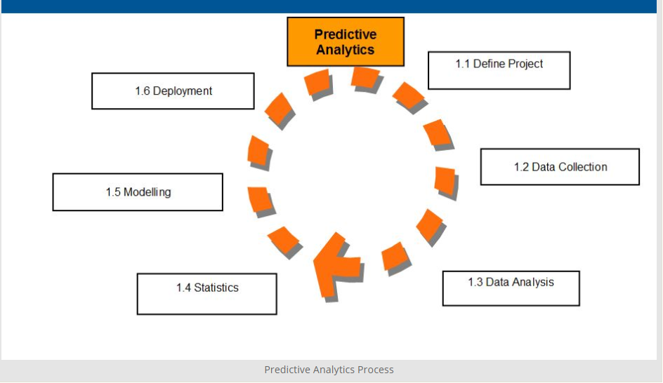
Predictive Analytics Process:

Slide 5
Predictive Analytics Process: (Contd.)
Define Project:
Define the project outcomes, deliverables, scoping of the effort, business objectives, identify the data sets which are going to be used.
Data Collection:
Data mining for predictive analytics prepares data from multiple sources for analytics. This provides a complete view of customer interactions.
Data analysis:
Data analysis is the process of inspecting ,cleaning, transforming, and modelling data with the objective of discoverable useful information, arriving at conclusions.
Statistics:
Statistical Analysis enables to validate the assumptions, hypothesis and test them with using standard statistical models.

Slide 6
Predictive Analytics Process: (Contd.)
Modelling:
Predictive modelling provides the ability to automatically create accurate predictive models about future.
Deployment:
Predictive model deployment provides the option to deploy the analytical results in to the everyday decision making process to get results.
Model Monitoring:
Models are monitored and managed to review the model performance to endure that it is providing the results expected.

Slide 7
Predictive Analytics: (Applications)
Customer Relationship Management
Health care
Collection Analytics
Cross sell
Fraud detection
Risk management
Direct Marketing
Underwriting

Slide 8
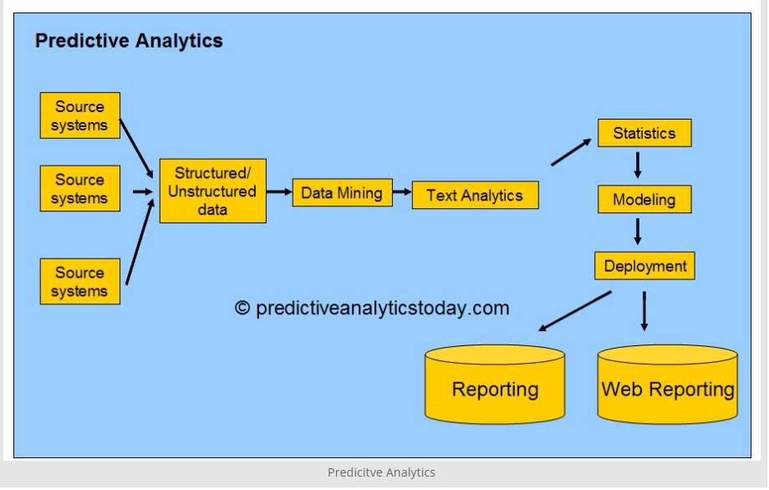
Predictive Analytics: (Applications)

Slide 9
Predictive analytics techniques that typically are applied:
Descriptive: This technique summarizes what has happened in the past and attempts to analyse and characterize it.
Correlation. Users can do correlation analysis to identify relationships and dependencies between different data variables to predict how they'll affect one another going forward.
Segmentation. This technique is a way to analyze a large collection of entity data, such as a customer database, and organize it into smaller groups.

Slide 10
Predictive analytics techniques that typically are applied:
Regression. This technique is designed to identify meaningful relationships among data variables, specifically looking at the connections between a dependent variable and other factors that may or may not affect it.
Association. One more technique for highlighting relationships between data elements for predictive purposes is to look for ones that demonstrate affinity.
Classification. Another means of separating different entities in a data set into related groups is to map them into predefined categories based on relevant characteristics or behaviours.

Slide 11
THANK YOU

